Slide 1
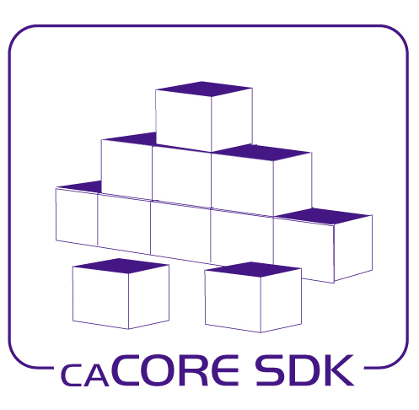

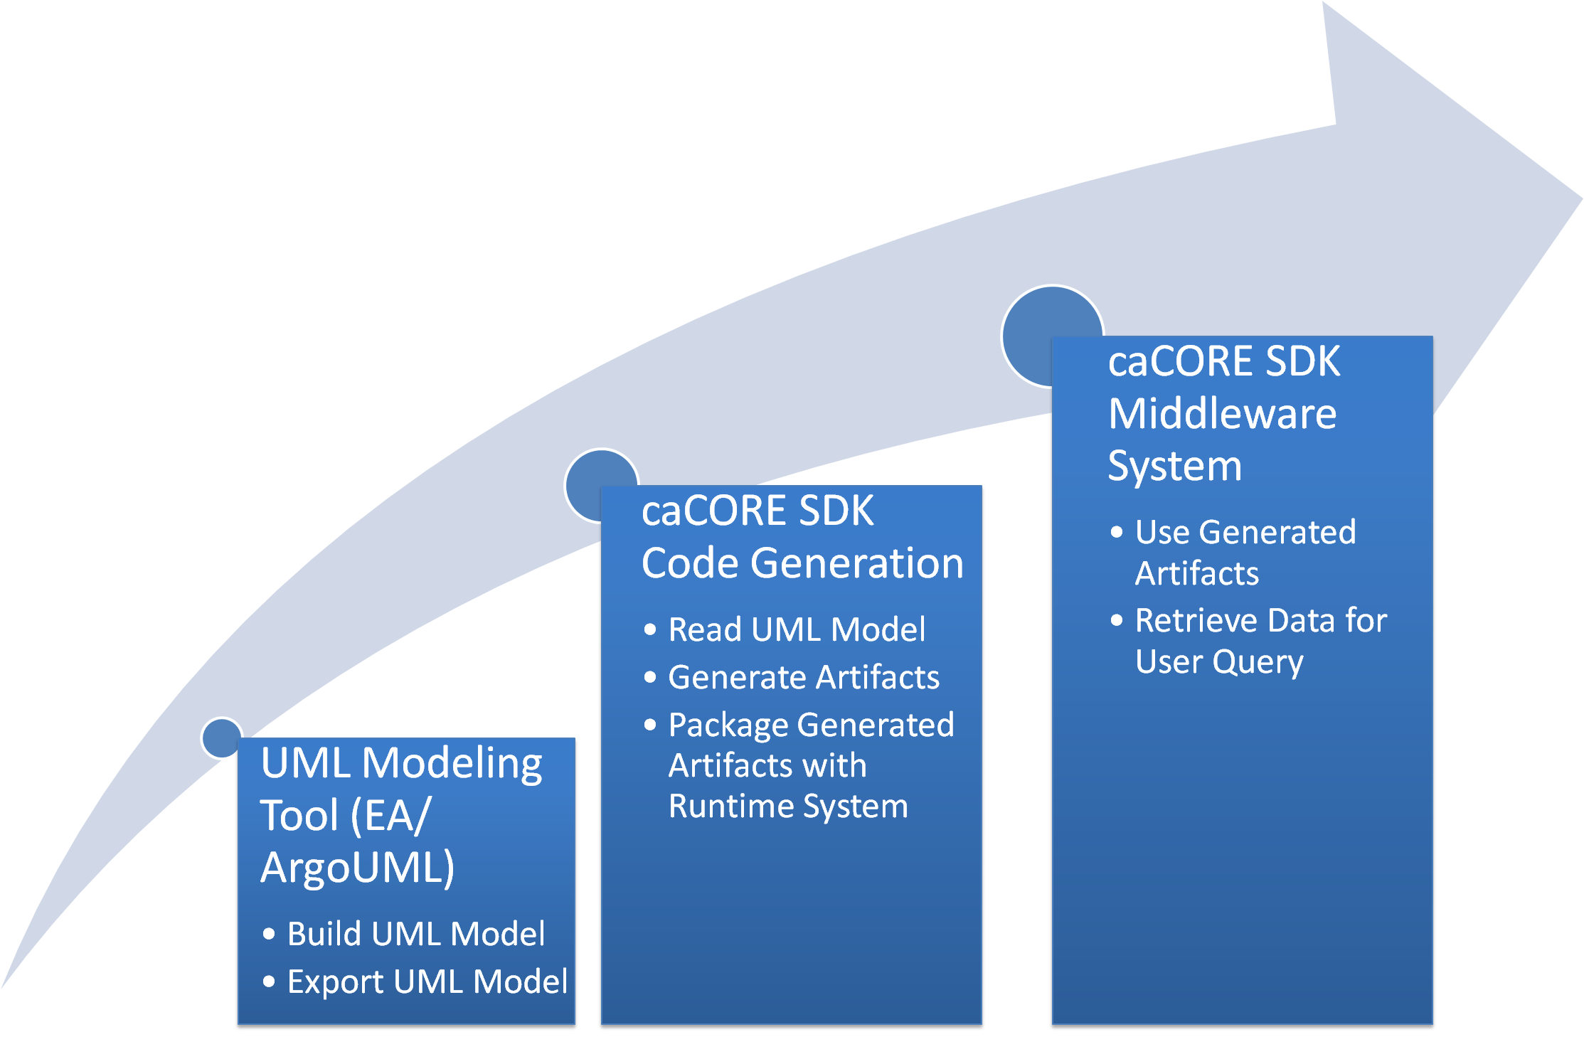











caCORE SDK 4.0 –
A Framework to Develop Data Sharing Applications
Satish Patel, Dan Dumitru, Santhosh Garmilla, Charles Griffin - Ekagra Software Technologies
Aynur Abdurazik - SAIC; Avinash Shanbhag, David Hau, Denise Warzel – NCI CBIIT
Email: CACORE_SDK_USERS-l@list.nih.gov
Ekagra
Overview
caCORE Software Development Kit (caCORE SDK) is NCI CBIIT’s tool that generates a data management framework to allow researchers to navigate through a large number of data sources. The caCORE SDK generated system is built on the principles of Model Driven Architecture (MDA), n-tier architecture and common APIs which allows for easy access to data, particularly by other applications in a secured or non secured fashion. When the caCORE SDK generated system is combined with controlled vocabularies and registered metadata, the resulting software system, called “caCORE-like” system, is “semantically integrated”. All exposed API elements have runtime accessible metadata that defines the elements using controlled terminology.
SDK System Generation Process
Build UML object model using Enterprise Architect /ArgoUML
Build UML data model using Enterprise Architect /ArgoUML
Export UML model in XMI/XML format
Perform O/R mapping using caAdapter
Configure caCORE SDK code generator
Run the code generator
Deploy the generated application
Query the database against deployed application
SDK Generated Middleware System
Core Services
Registered in
Registered in
Semantically described with terminology from
Object
Definition
WSDL
XSD
SDK Service
Map to
Service Definition
Validate against
SDK Service API
SDK Client API
Grid Service
Generated by Introduce
Grid Client API
Java API
Client App
Oracle
Database
Reads
Java Interface
Objects
XML
Objects
MySQL
Database
Reads
Objects
Objects
Java API
WSDL
XSD
Client uses
Service Definition
Validate against
CSM
Security
Database
Web Service Interface
Web Service
Client uses
Checks
XML
Internet Browser
HTTP Interface
HTTP/REST
XML/ HTML
SDK 4.0 Features
Supports ArgoUML and Enterprise Architect for UML modeling
Provides various interfaces to access underlying database
Standardized Query By Example (QBE) based data access interfaces built on application’s domain model
Ability to navigate through more than one data source
Integrated security with Common Security Module (CSM)
Seamless integration with the caGrid tools to create a grid service
Upcoming SDK 4.1 Features
Fully functional writable API allowing users to edit the underlying database
Integrated validator to implement custom validation as well as validation against the caDSR Enumerated value domains
Integrated logging and auditing functionality with Common Logging Module (CLM)
Enhanced O/R mapping to support primary key generators, cascade settings etc
GME Namespace based XSD generation

